Slide 3
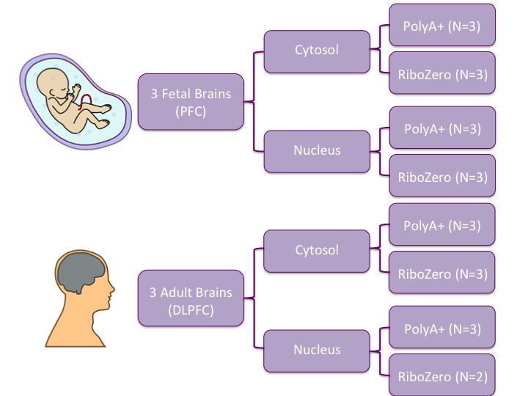
Supplementary Figure 1: Experimental Design
We characterized the nuclear and cytoplasmic transcriptome in prenatal and adult human postmortem prefrontal cortex using two RNA sequencing library preparation methods. “PolyA” library preparation selects polyadenylated transcripts via a pull-down step, while “Ribozero” library preparation relies on a rRNA depletion step.

Slide 4
A.
B.
E.
⬆ Nucleus
⬆ Cytosol
C.
F.
D.
Supplementary Figure 2: Characterizing the nuclear and cytoplasmic transcriptome in human brain
Differentially expressed genes by library type.
ACTB1, a cytoplasmic gene, and MALAT1, a nuclear gene, are enriched in the appropriate fractions.
Percent of reads mapping to six genomic features in each group.
Proportion of reads including a splice junction by group.
Length distribution of genes enriched by fraction in polyA samples.
Principle component analysis where PC1 captures variance due to age and PC2 captures library type.

